Slide 1
Your First Firebase Project

Slide 2


Slide 3
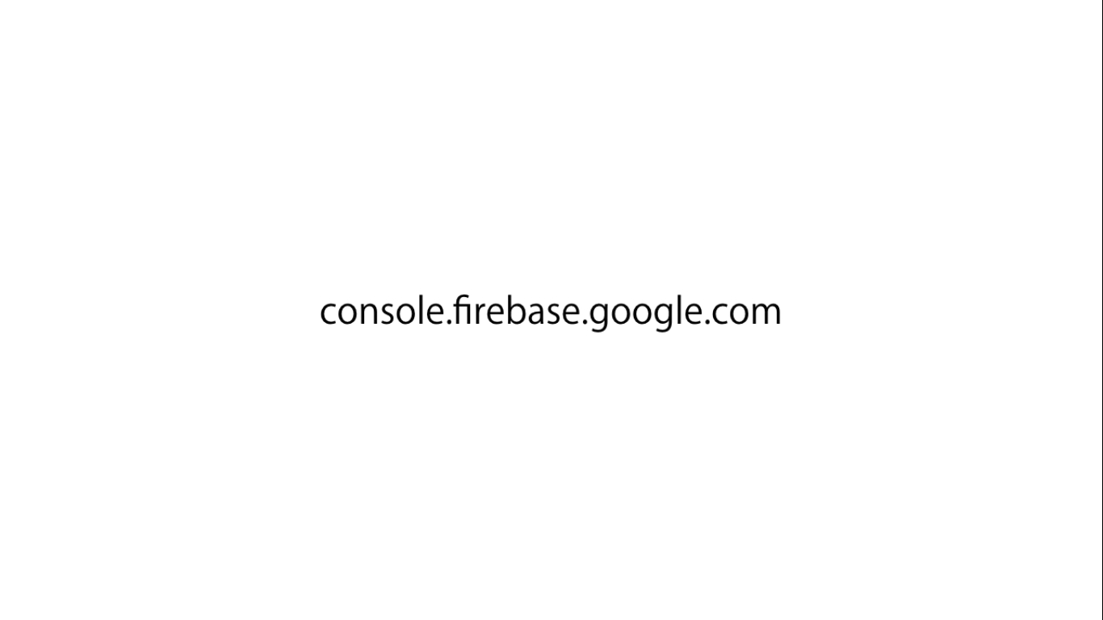

Slide 4
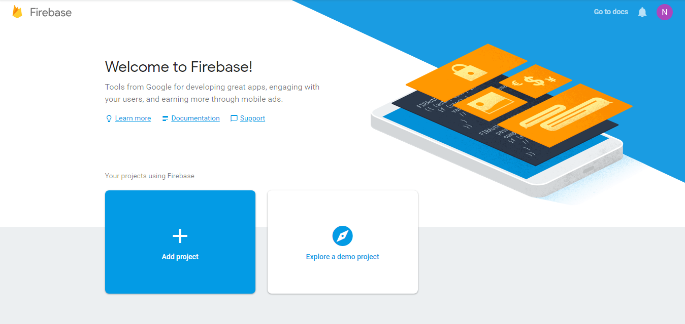

Slide 5
